Slide 1

Data Integration and Large Scale Analysis 09 Distributed Data Storage
Slides Credit: Matthias Boehm
Last update: Dec 15, 2023

Slide 2
Announcements/Org
Course Evaluation and Exam
Exercise submission deadline Jan 12
Evaluation period: Dec 01 – Feb 15
Exam date: Feb 02, 3:00pm (90 min written exam)
Second Exam data: TBA (probably after 2 weeks of first exam)

Slide 3
Course Outline Part B: Large-Scale Data Management and Analysis
12 Distributed Stream Processing
13 Distributed Machine Learning Systems
11 Distributed Data-Parallel Computation
Compute/ Storage
10 Distributed Data Storage
09 Cloud Resource Management and Scheduling
Infra
08 Cloud Computing Fundamentals

Slide 4
Agenda
Motivation and Terminology
Object Stores and Distributed File Systems
Key-Value Stores and Cloud DBMS

Slide 5
Motivation and Terminology

Slide 6
Overview Distributed Data Storage
Motivation and Terminology
Global Q
Recap: Distributed DBS (03 Replication, MoM, and EAI)
Distributed DB: Virtual (logical) DB, appears like a local DB but consists of multiple physical DBs
Components for global query processing
Virtual DBS (homo.) vs federated DBS (hetero.)
Cloud and Distributed Data Storage
Motivation: size (large-scale), semi-structured/nested , fault tolerance
#1 Cloud and Distributed Storage
Block storage: files split into blocks, read/write (e.g., SAN, AWS EBS)
Object storage: objects of limited size (e.g., 5TB), get/put (e.g., AWS S3)
Distributed file systems: file system on block/object stores (NFS, HDFS)
#2 Database as a Service
NoSQL stores: Key-value stores, document stores
Cloud DBMSs (SQL, for OLTP and OLAP workloads)
DB₁
Q’
Q’’’
Q’’
DB₂
DB₄
DB₃

Slide 7
Central Data Abstractions
Motivation and Terminology
#1 Files and Objects
File: Arbitrarily large sequential data in specific file format (CSV, binary, etc)
Object: binary large object, with certain meta data
#2 Distributed Collections
Logical multi-set (bag) of key-value pairs (unsorted collection)
Different physical representations
Easy distribution of pairs via horizontal partitioning (aka shards, partitions)
Can be created from single file, or directory of files (unsorted)
Key | Value
4 | Delta
2 | Bravo
1 | Alfa
3 | Charlie
5 | Echo
6 | Foxtrot
7 | Golf
1 | Alfa

Slide 8

Data Lakes
Motivation and Terminology
Concept “Data Lake”
Store massive amounts of un/semi-structured, and structured data (append only, no update in place)
No need for architected schema or upfront costs (unknown analysis)
Typically: file storage in open, raw formats (inputs and intermediates)
➔ Distributed storage and analytics for scalability and agility
Criticism: Data Swamp
Low data quality (lack of schema, integrity constraints, validation)
Missing meta data (context) and data catalog for search
➔ Requires proper data curation / tools According to priorities (data governance)
[Credit: www.collibra.com]

Slide 9
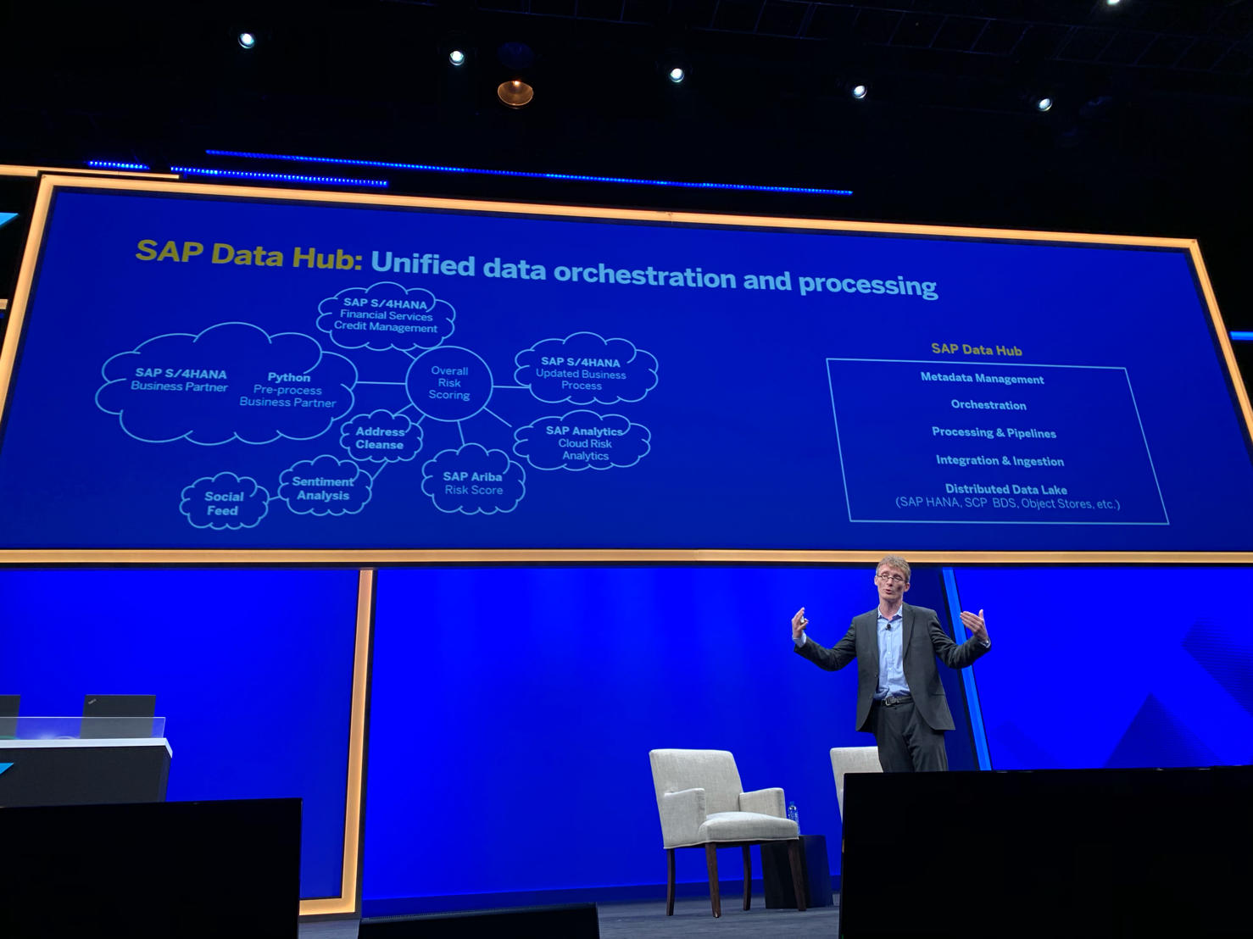
Catalogs of Data and Artefacts
Motivation and Terminology
Data Catalogs
Data curation in repositories for finding relevant datasets in data lakes
Augment data with open and linked data sources
Examples
[Alon Y. Halevy et al: Goods: Organizing Google's Datasets. SIGMOD 2016]
SAP Data Hub
Google Data Search
[SAP Sapphire Now 2019]

Slide 10
Object Stores and Distributed File Systems

Slide 11
Object Storage
Object Stores and Distributed File Systems
Recap: Key-Value Stores
Key-value mapping, where values can be of a variety of data types
APIs for CRUD operations; scalability via sharding (objects or object segments)
Object Store
Similar to key-value stores, but: optimized for large objects in GBs and TBs
Object identifier (key), meta data, and object as binary large object (BLOB)
APIs: often REST APIs, SDKs, sometimes implementation of DFS APIs
Key Techniques
Partitioning
Replication & Distribution
Erasure Coding (partitioning + parity)
Partitioning
D₁
Replication
D₁₁
D₁₂
D
D₂
D₂₁
D₂₂
D₃
D₃₁
D₃₂
Distribution
D₁₁
D₁₂
D₂₁
D₃₂
D₂₂
D₃₁

Slide 12


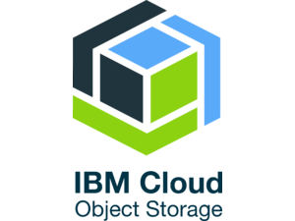
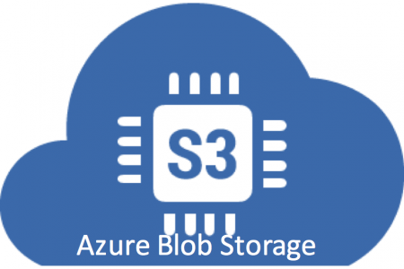
Object Storage, cont.
Object Stores and Distributed File Systems
Example Object Stores / Protocols
Amazon Simple Storage Service (S3)
OpenStack Object Storage (Swift)
IBM Object Storage
Microsoft Azure Blob Storage
Example Amazon S3
Reliable object store for photos, videos, documents or any binary data
Bucket: Uniquely named, static data container http://s3.aws-eu-central-1.amazonaws.com/<identifier>
Object: key, version ID, value, metadata, access control
Single (5GB)/multi-part (5TB) upload and direct/BitTorrent download
Storage classes: STANDARD, STANDARD_IA, GLACIER, DEEP_ARCHIVE
Operations: GET/PUT/LIST/DEL, and SQL over CSV/JSON objects

Slide 13

Hadoop Distributed File System (HDFS)
Object Stores and Distributed File Systems
Brief Hadoop History
Google’s GFS + MapReduce [ODSI’04] → Apache Hadoop (2006)
Apache Hive (SQL), Pig (ETL), Mahout/SystemML (ML), Giraph (Graph)
HDFS Overview
Hadoop’s distributed file system, for large clusters and datasets
Implemented in Java, w/ native libraries for compression, I/O, CRC32
Files split into 128MB blocks, replicated (3x), and distributed
[Sanjay Ghemawat, Howard Gobioff, Shun-Tak Leung: The Google file system. SOSP 2003]
Client
Hadoop Distributed File System (HDFS)
Name Node
Data Node
Data Node
Data Node
Data Node
Data Node
Data Node
M
1
2
3
4
5
6
Head Node
Worker Nodes (shared-nothing cluster)
Notes:
Number of disks – number of cores

Slide 14
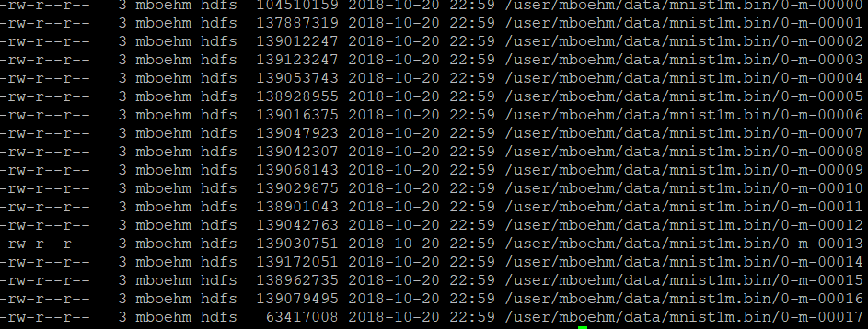
HDFS Daemon Processes
Object Stores and Distributed File Systems
HDFS NameNode
Master daemon that manages file system namespace and access by clients
Metadata for all files (e.g., replication, permissions, sizes, block ids, etc)
FSImage: checkpoint of FS namespace
EditLog: write-ahead-log (WAL) of file write operations (merged on startup)
HDFS DataNode
Worker daemon per cluster node that manages block storage (list of disks)
Block creation, deletion, replication as individual files in local FS
On startup: scan local blocks and send block report to name node
Serving block read and write requests
Send heartbeats to NameNode (capacity, current transfers) and receives replies (replication, removal of block replicas)
hadoop fs -ls ./data/mnist1m.bin
Notes:
Note: multiple fsimage/editlogs can be configured + synchronously written for fault tolerance

Slide 15
HDFS InputFormats and RecordReaders
Object Stores and Distributed File Systems
Overview InputFormats
InputFormat: implements access to distributed collections in files
Split: record-aligned block of file (aligned with HDFS block size)
RecordReader: API for reading key-value pairs from file splits
Examples: FileInputFormat, TextInputFormat, SequenceFileInputFormat
Example Text Read
FileInputFormat.addInputPath(job, path); # path: dir/file
TextInputFormat informat = new TextInputFormat();
InputSplit[] splits = informat.getSplits(job, numSplits);
LongWritable key = new LongWritable();
Text value = new Text();
for(InputSplit split : splits) {
RecordReader<LongWritable,Text> reader = informat .getRecordReader(split, job, Reporter.NULL);
while( reader.next(key, value) )
... //process individual text lines
}

Slide 16
HDFS InputFormats and RecordReaders, cont.
Object Stores and Distributed File Systems
Sequence Files
Binary files for key/value pairs, w/ optional compression (MapReduce/Spark inputs/outputs, MapReduce intermediates)
InputFormat with readers, writers, and sorters
Example Uncompressed SequenceFile
Header: SEQ+version (4 bytes), keyClassName, valueClassName, compression, blockCompression, compressor class (codec), meta data
Splittable binary representation of key-value pair collection
Header
Record
Record
Record
Record
Sync
Sync
Record Length
Key Length
Key
Value
SystemDS: values are 1k x 1k matrix blocks

Slide 17
HDFS Write and Read
Object Stores and Distributed File Systems
Client
D
HDFS Write
#1 Client RPC to NameNode to create file → lease/replica DNs
#2 Write blocks to DNs, pipelined replication to other DNs
#3 DNs report to NN via heartbeat
HDFS Read
#1 Client RPC to NameNode to open file → DNs for blocks
#2 Read blocks sequentially from closest DN w/ block
InputFormats and RecordReaders as abstraction for multi-part files (incl. compression/encryption)
1. Create foo.txt
HDFS Client
D₁
2
D₂
foo.txt: D1-1,2
D2-1,2
3
Name Node
Data Node
Data Node
M
1
2
D₁
D₂
D₁
D₂
1. Open foo.txt
HDFS Client
D₁
2
D₂
foo.txt: D1-1,2
D2-1,2
Name Node
Data Node
Data Node
M
1
2
D₁
D₂
D₁
D₂
Notes:
Note: writes synchronous but pipelined replication; if less than k data nodes returned (errors, loaded) write still successful if replication > min.replication

Slide 18
HDFS Data Locality
Object Stores and Distributed File Systems
Data Locality
HDFS is generally rack-aware (node-local, rack-local, other)
Schedule reads from closest data node
Replica placement (rep 3): local DN, other-rack DN, same-rack DN
MapReduce/Spark: locality-aware execution (function vs data shipping)
Custom Locality Information
Custom InputFormat and FileSplit implementations
Return customized mapping of locations on getLocations()
Can use block locations of arbitrary files
public class MyFileSplit extends FileSplit
{
public MyFileSplit(FileSplit x, ...) {}
@Override
public String[] getLocations() {
return new String[]{“node1”,“node7”};
}
}
FileStatus st = fs.getFileStatus(new Path(fname));
BlockLocation[] tmp1 = fs.getFileBlockLocations(st, 0, st.getLen());

Slide 19
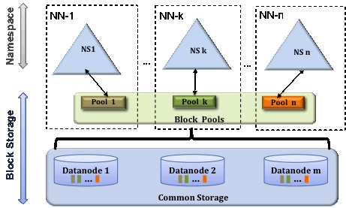
HDFS Federated NameNodes
Object Stores and Distributed File Systems
HDFS Federation
Eliminate NameNode as namespace scalability bottleneck
Independent NameNodes, responsible for name spaces
DataNodes store blocks of all NameNodes
Client-side mount tables
GFS Multiple Cells
“We also ended up doing what we call a "multi-cell" approach, which basically made it possible to put multiple GFS masters on top of a pool of chunkservers.” -- Sean Quinlan
[Credit: https://hadoop.apache.org/docs/current/hadoop-project-dist/hadoop-hdfs/Federation.html]
[Kirk McKusick, Sean Quinlan: GFS: evolution on fast-forward. Commun. ACM 53(3) 2010]

Slide 20
Other DFS
Object Stores and Distributed File Systems
HDFS FileSystem Implementations (subset)
LocalFileSystem (file), DistributedFileSystem (hdfs)
FTPFileSystem, HttpFileSystem, ViewFilesystem (ViewFs – mount table)
NativeS3FileSystem (s3, s3a), NativeSwiftFileSystem, NativeAzureFileSystem
Other proprietary: IBM GPFS, Databricks FS (DBFS)
Google Colossus
More fine-grained accesses, Google Cloud Storage
High-Performance Computing
Scope: Focus on high IOPs (instead of bandwidth) with block write
IBM GPFS (General Parallel File System) / Spectrum Scale
BeeGFS (Fraunhofer GFS) – focus on usability, storage/metadata servers
Lustre (Linux + Cluster) – GPL license, LNET protocol / metadata / object storage
RedHat GFS2 (Global File System) – Linux cluster file system, close to local
NAS (Network Attached Storage), SAN (Storage Area Network)
GekkoFS (Uni Mainz / Barcelona SC) – data-intensive HPC applications
[WIRED: Google Remakes Online Empire With 'Colossus', https://www.wired.com/2012/07/google-colossus/]

Slide 21
Key-Value Stores and Cloud DBMS

Slide 22

Motivation and Terminology
Key-Value Stores and Cloud DBMS
Motivation
Basic key-value mapping via simple API (more complex data models can be mapped to key-value representations)
Reliability at massive scale on commodity HW (cloud computing)
System Architecture
Key-value maps, where values can be of a variety of data types
APIs for CRUD operations (create, read, update, delete)
Scalability via sharding (horizontal partitioning)
Example Systems
Dynamo (2007, AP) → Amazon DynamoDB (2012)
Redis (2009, CP/AP)
users:1:a
“Inffeldgasse 13, Graz”
users:1:b
“[12, 34, 45, 67, 89]”
users:2:a
“Mandellstraße 12, Graz”
users:2:b
“[12, 212, 3212, 43212]”
[Giuseppe DeCandia et al: Dynamo: amazon's highly available key-value store. SOSP 2007]
Notes:
Notes:
Dynamo + SimpleDB → DynamoDB
1 MB range

Slide 23
Example Systems: Dynamo
Key-Value Stores and Cloud DBMS
[Giuseppe DeCandia et al: Dynamo: amazon's highly available key-value store. SOSP 2007]
Motivation
Simple, highly-available data storage for small objects in ~1MB range
Aim for good load balance (99.9th percentile SLAs)
#1 System Interface
Simple get(k, ctx) and put(k, ctx) ops
#2 Partitioning
Consistent hashing of nodes and keys on circular ring for incremental scaling
Nodes hold multiple virtual nodes for load balance (add/rm, heterogeneous)
#3 Replication
Each data item replicated N times (at coord node and N-1 successors)
Eventual consistency with async update propagation based on vector clocks
Replica synchronization via Merkle trees
Amazon e-Commerce Platform
Notes:
Notes:
* vector clocks (node, counter) for capturing causality between versions
* Replica synchronization via anti-entropy and Merkle-trees

Slide 24










Example Systems, cont.
Key-Value Stores and Cloud DBMS
Redis Data Types
Redis is not a plain KV-store, but “data structure server” with persistent log (appendfsync no/everysec/always)
Key: ASCII string (max 512MB, common key schemes: comment:1234:reply.to)
Values: strings, lists, sets, sorted sets, hashes (map of string-string), etc
Redis APIs
SET/GET/DEL: insert a key-value pair, lookup value by key, or delete by key
MSET/MGET: insert or lookup multiple keys at once
INCRBY/DECBY: increment/decrement counters
Others: EXISTS, LPUSH, LPOP, LRANGE, LTRIM, LLEN, etc
Other systems
Classic KV stores (AP): Riak, Aerospike, Voldemort, LevelDB, RocksDB, FoundationDB, Memcached
Wide-column stores: Google BigTable (CP), Apache HBase (CP), Apache Cassandra (AP)

Slide 25
Log-structured Merge Trees
Key-Value Stores and Cloud DBMS
[Patrick E. O'Neil, Edward Cheng, Dieter Gawlick, Elizabeth J. O'Neil: The Log-Structured Merge-Tree (LSM-Tree). Acta Inf. 1996]
LSM Overview
Many KV-stores rely on LSM-trees as their storage engine (e.g., BigTable, DynamoDB, LevelDB, Riak, RocksDB, Cassandra, HBase)
Approach: Buffers writes in memory, flushes data as sorted runs to storage, merges runs into larger runs of next level (compaction)
System Architecture
Writes in C0
Reads against C0 and C1 (w/ buffer for C1)
Compaction (rolling merge): sort, merge, including deduplication
C0
in-memory buffer (C0) max capacity T
writes
reads
compaction
C1_{t}
on-disk storage (C1)
C1_{t+1}
Notes:
Note: LSM write optimized by buffering writes, read-optimized by sort-merging on-disk runs
C1 and Ci also trees similar to B-tree but nodes kept 100% full single node pages packed into multi-page blocks
→ Better insert performance, worse lookup costs

Slide 26
Log-structured Merge Trees, cont.
Key-Value Stores and Cloud DBMS
write-optimized
LSM Tiering (write optimized)
Keep up to T-1 runs per level L
Merge all runs of L_{i} into 1 run of L_{i+1}
L1
L2
L3
LSM Leveling (read optimized)
Keep 1 run per level L
Merge run of Li with Li+1
L1
L2
L3
read-optimized
[Niv Dayan: Log-Structured-Merge Trees, Comp115 guest lecture, 2017]
[Stratos Idreos, Mark Callaghan: Key-Value Storage Engines (Tutorial), SIGMOD 2020]

Slide 27


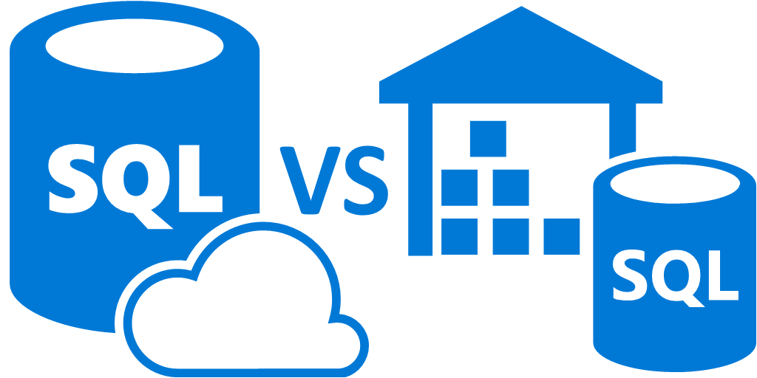
Cloud Databases (DBaaS)
Key-Value Stores and Cloud DBMS
Motivation DBaaS
Simplified setup, maintenance, tuning and auto scaling
Multi-tenant systems (scalability, learning opportunities)
Different types based on workload (OLTP vs OLAP)
Elastic Data Warehouses
Motivation: Intersection of data warehousing (02 DWH, ETL, SQL/OLAP), cloud computing (07/08 Cloud Computing), Distributed Storage (09 today)
Example Systems
#1 Snowflake
#2 Google BigQuery (Dremel)
#3 Amazon Redshift
Azure SQL Data Warehouse
Microsoft
Commonalities:
SQL, column stores, data on object store / DFS, elastic cloud scaling

Slide 28

Example Snowflake
Key-Value Stores and Cloud DBMS
[Benoît Dageville et al.: The Snowflake Elastic Data Warehouse. SIGMOD 2016]
Motivation (impl started late 2012)
Enterprise-ready DWH solution for the cloud (elasticity, semi-structured)
Pure SaaS experience, high availability, cost efficient
Cloud Services
Manage virtual DHWs, TXs, and queries
Meta data and catalogs
Virtual Warehouses
Query execution in EC2
Caching/intermediates
Data Storage
Storage in AWS S3
PAX / hybrid columnar
Min-max pruning
Notes:
Note: Sep 2020 -> IPO (initial public offering), 33B eval

Slide 29
Example Google BigQuery
Key-Value Stores and Cloud DBMS
[Sergey Melnik et al.: Dremel: Interactive Analysis of Web-Scale Datasets. PVLDB 3(1) 2010]
Background Dremel
Scalable and fast in-situ analysis of read-only nested data (DFS, BigTable)
Data model: protocol buffers - strongly-typed nested records
Storage model: columnar storage of nested data (efficient splitting and assembly records)
Query execution via multi-level serving tree
BigQuery System Architecture
Public impl of internal Dremel system (2012)
SQL over structured, nested data (OLAP, BI)
Extensions: web Uis, REST APIs and ML
Data storage: Colossus (NextGen GFS)
[Kazunori Sato: An Inside Look at Google BigQuery, Google BigQuery White Paper 2012.]

Slide 30
Example Amazon Redshift
Key-Value Stores and Cloud DBMS
[Anurag Gupta et al.: Amazon Redshift and the Case for Simpler Data Warehouses. SIGMOD 2015]
Motivation (release 02/2013)
Simplicity and cost-effectiveness (fully-managed DWH at petabyte scale)
System Architecture
Data plane: data storage and SQL execution
Control plane: workflows for monitoring, and managing databases, AWS services
Data Plane
Initial engine licensed from ParAccel
Leader node + sliced compute nodes in EC2 (with local storage)
Replication across nodes + S3 backup
Query compilation in C++ code
Support for flat and nested files
[Mengchu Cai et al.: Integrated Querying of SQL database data and S3 data in Amazon Redshift. IEEE Data Eng. Bull. 41(2) 2018]

Slide 31
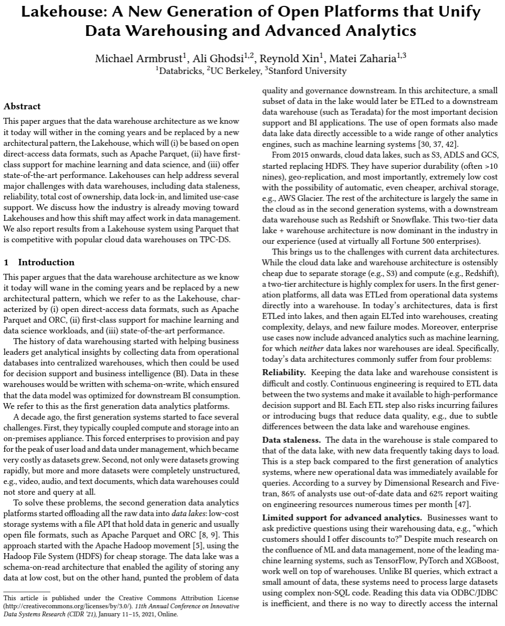
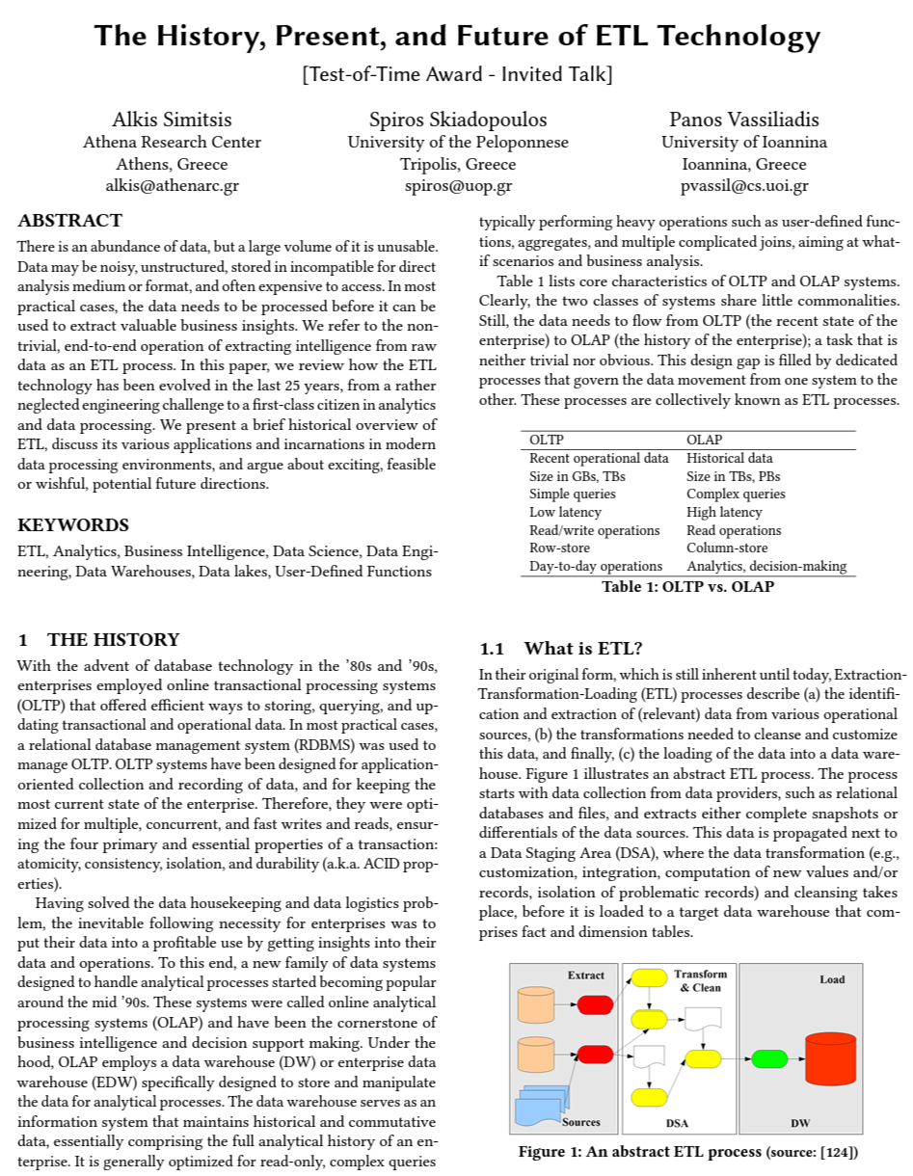
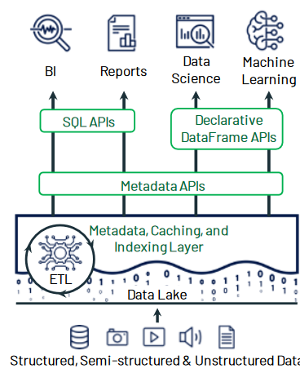
Lakehouse
Lakehouse
[Matei Zahari et. al, Lakehouse: A New Generation of Open Platforms that Unify Data Warehousing and Advanced Analytics. CIDR 2021]
Data Lake
Collection of structured, semi and
unstructured data, schema-on-read
Delta Lake
A storage layer sits on top of data lake
ACID transactions, schema enforcement
schema evolution, meta handling, time travel
Lakehouse
Extends delta lake for BI & ML workloads
Hybrid architecture for structured and
semi-structured data processing
Delta lake (open source project)
Databricks Lakehouse platform, MS Azure Synapse
[Alkis Simitsis et. al., The History, Present, and Future of ETL Technology, DOLAP 2023]

Slide 32
Summary and Q&A
Motivation and Terminology
Object Stores and Distributed File Systems
Key-Value Stores and Cloud DBMS
Next Lectures
11 Distributed, Data-Parallel Computation [Jan 12]
12 Distributed Stream Processing [Jan 19]
13 Distributed Machine Learning Systems [Jan 19]

